Slide 1
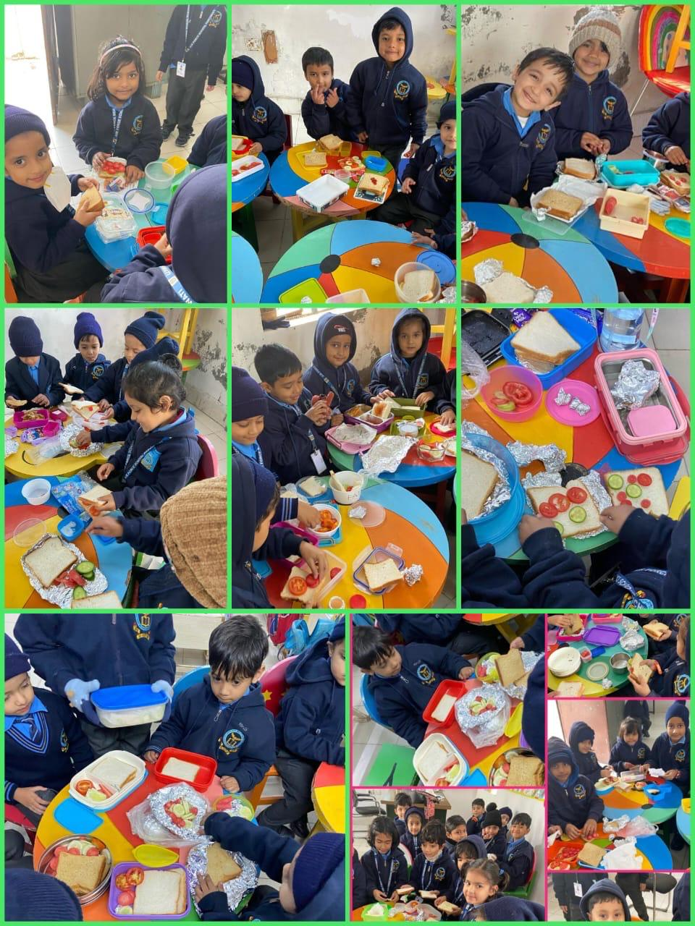
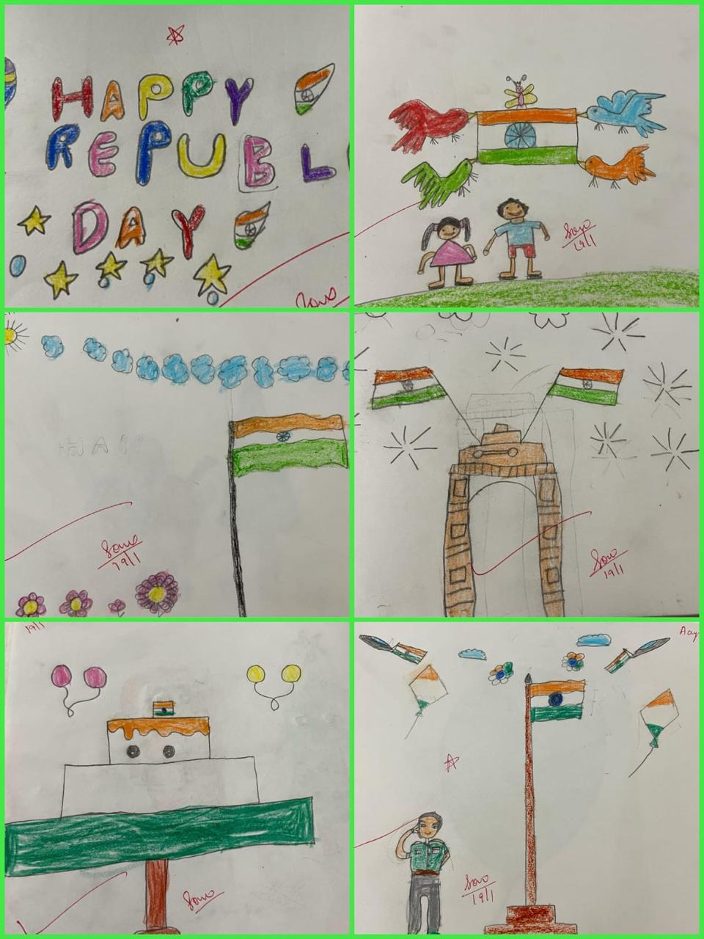
AIR FORCE SCHOOL PANCHWATI
JANUARY-MARCH
2024
SANDWICH MAKING
Sandwich making was done by tiny tots on 18/01/24. Developing life skills for kids is a great way to encourage independence, practice fine-motor skills, and foster self-confidence.
REPUBLIC DAY
India's Republic Day, celebrated on January 26th, marks the enactment of the Constitution in 1950, transforming the country into a sovereign, socialist, secular, and democratic republic

Slide 2
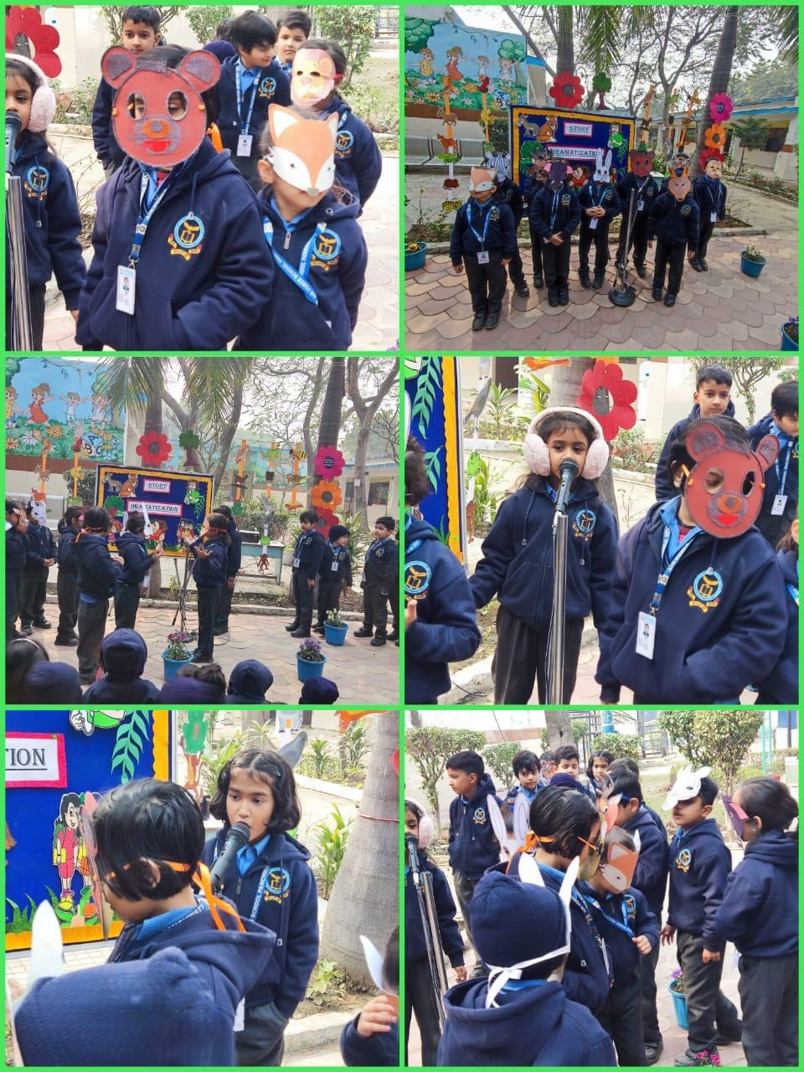
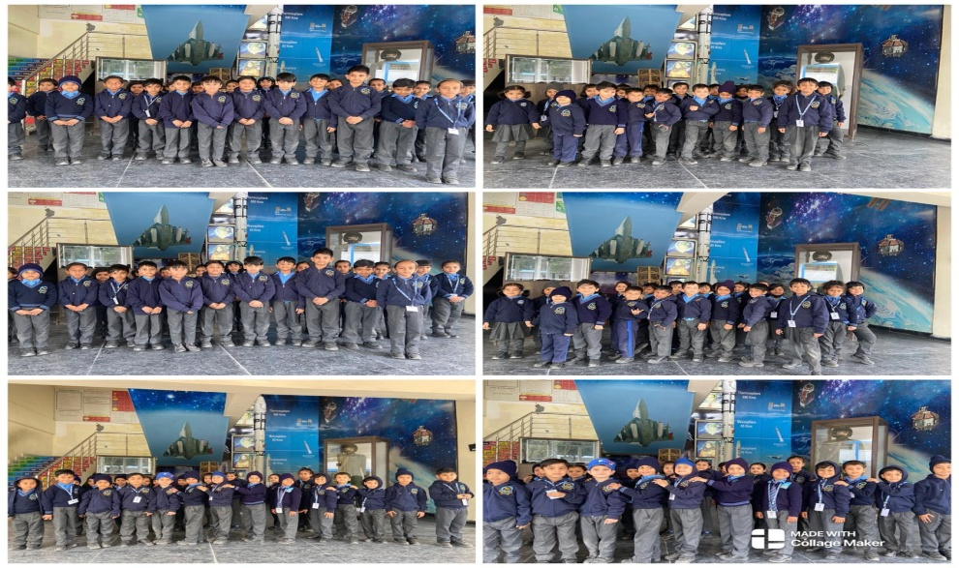
STORY DRAMATIZATION
Story dramatization was done by children in the guidance of teacher on 29/01/24. Story dramatization is the re-creation of part or all of a story with the emphasis on spontaneity, cognition, action, identification, dialogue and sequence of events.
SPACE WALK
Space walk activity was conducted on 26/02/24. Any time an astronaut gets out of a vehicle while in space, it is called a spacewalk

Slide 3
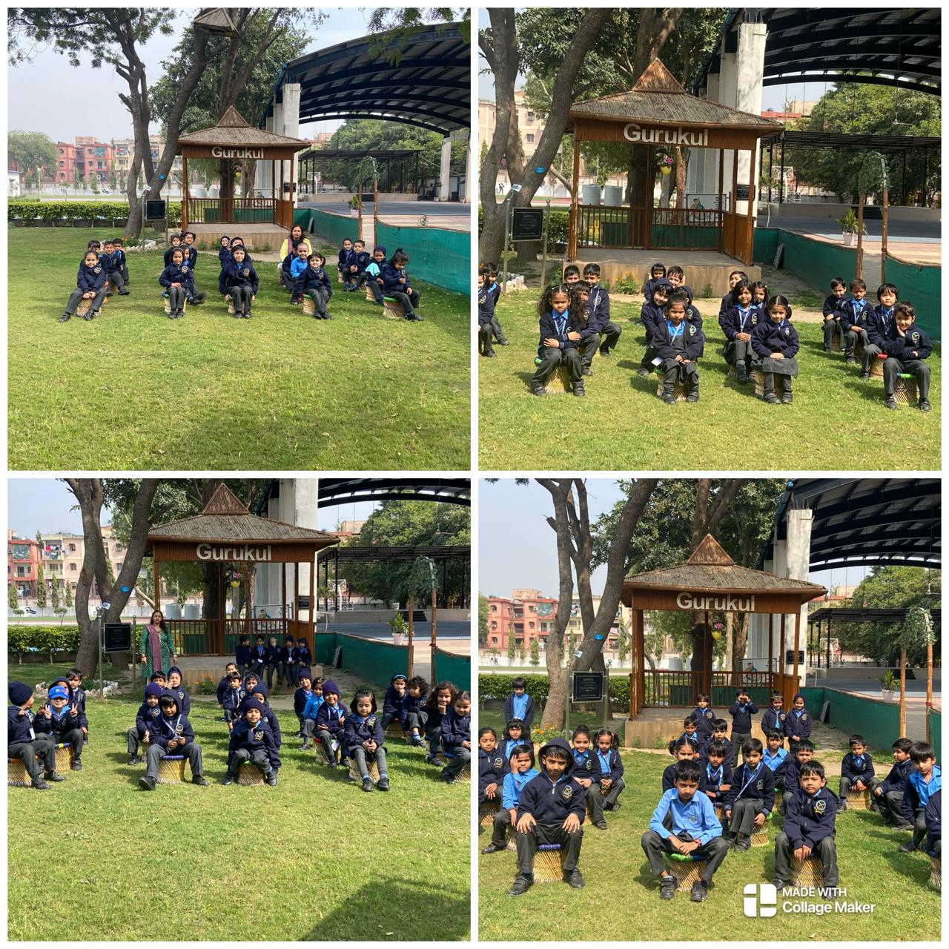
GURUKUL
Gurukul visit was done on 05/02/24. In a gurukul, students had to memorise lessons that were taught orally

